Slide 1
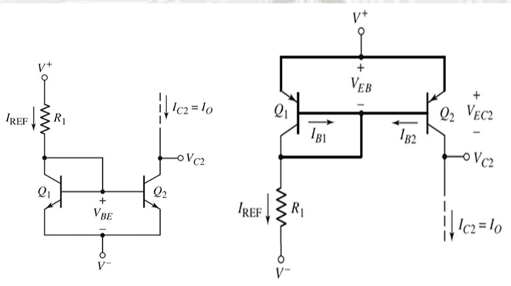
Current Mirrors
There are special current source structures suitable for use in integrated circuit structures. One of them is the current mirror.
a) with npn transistors
b) with pnp transistors

Slide 2
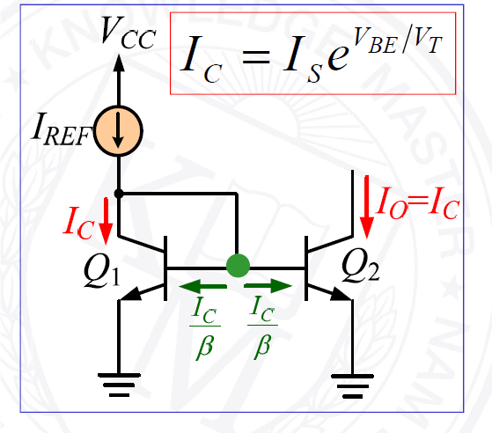
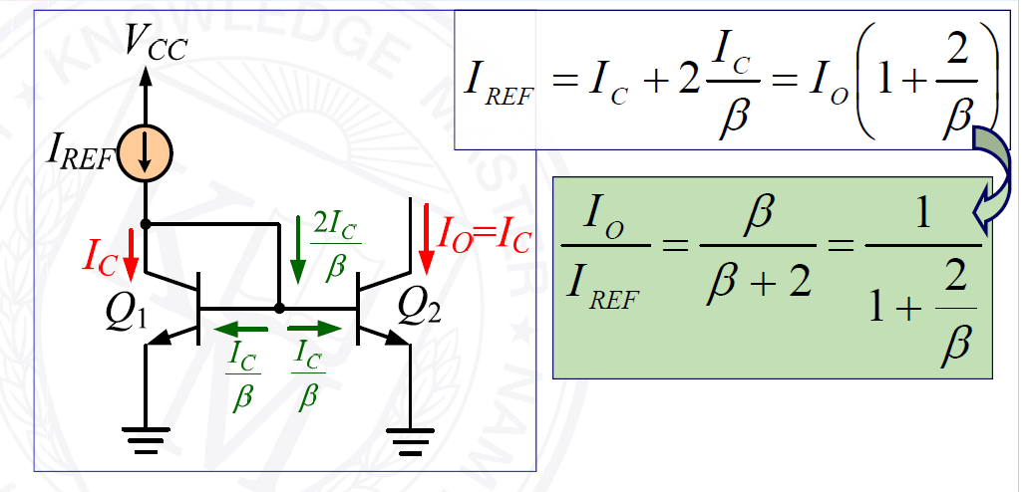
Current Mirrors

Slide 3
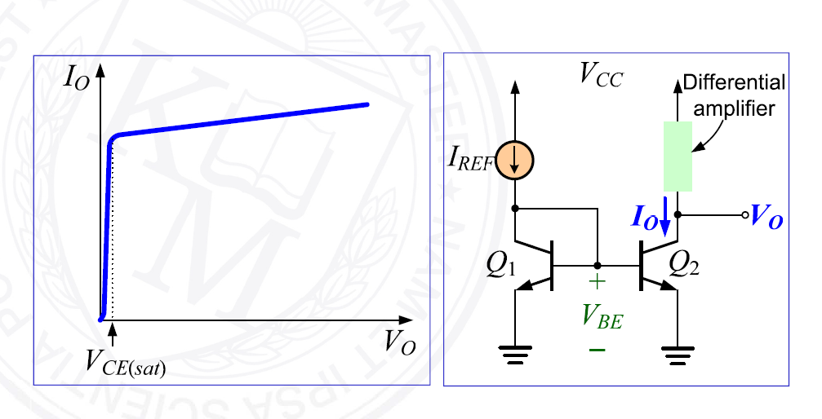
Current Mirrors

Slide 4
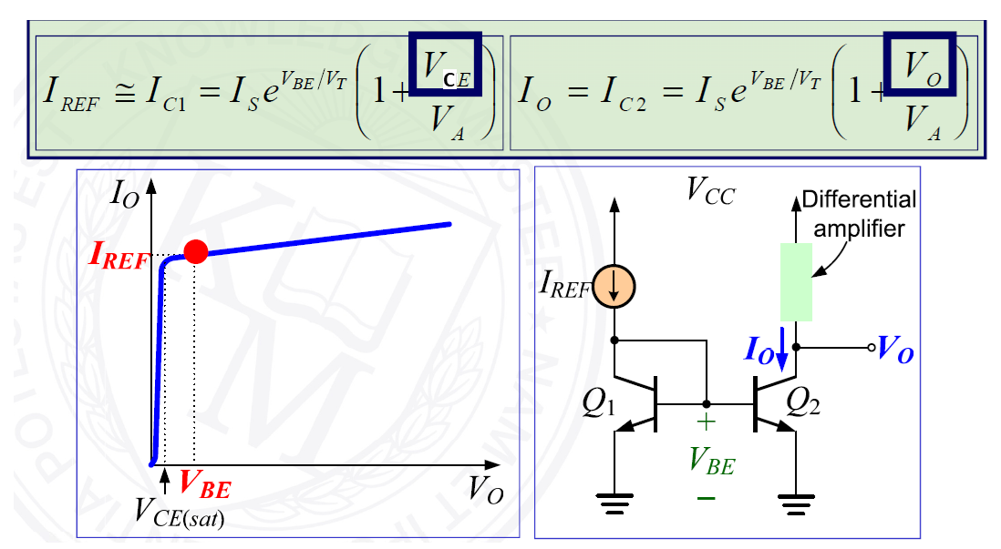
Current Mirrors

Slide 5
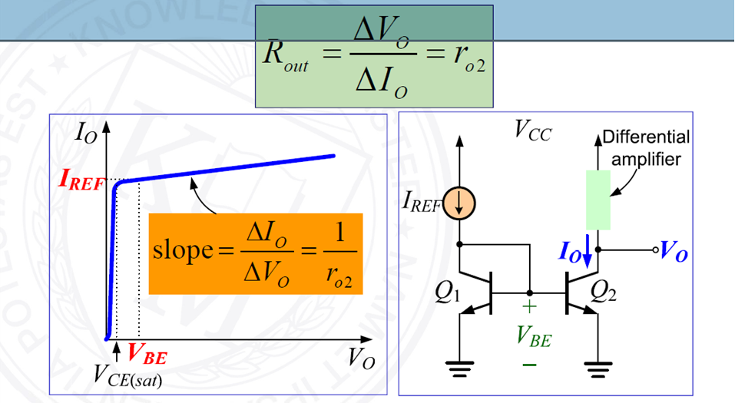
Sonlu Çıkış Direnci

Slide 6
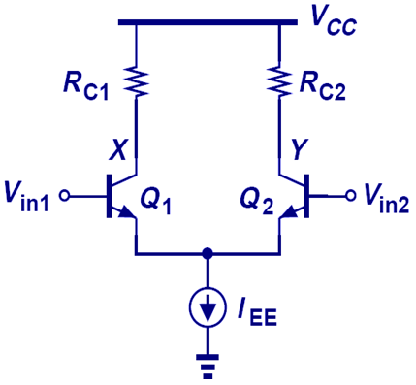
BJT Differential Pair
With the addition of a “tail current,” an elegant and robust differential pair is achieved. Transistors are exactly the same.

Slide 7


Differential Amplifiers
$$I_{C}=I_{S}\exp{\frac{V_{BE}}{V_{T}}}$$
$$I_{C}={αI}_{E}$$

Slide 8
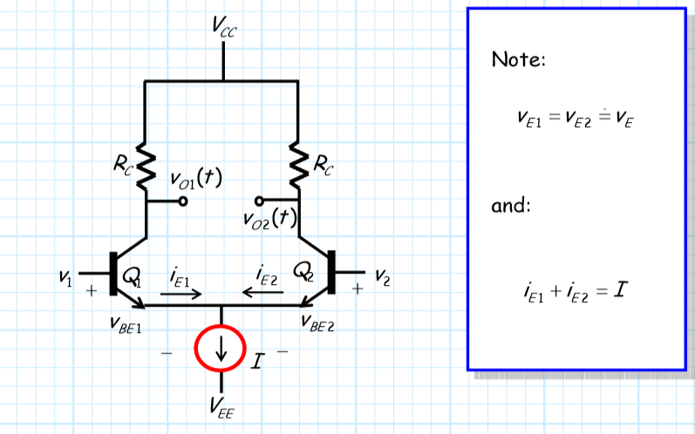
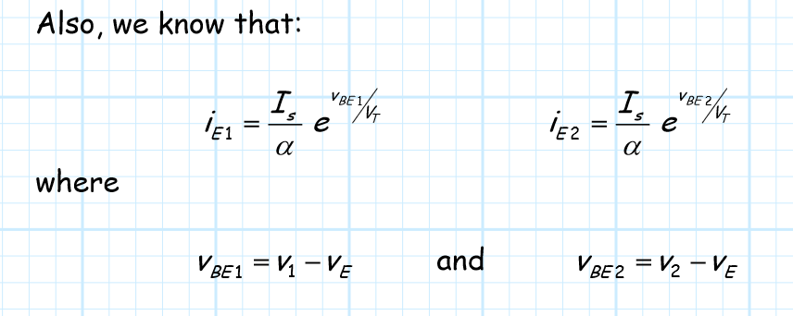
BJT Differential Pair (Uzun Kuyruklu Devre)
The circuit is obtained by biasing two conjugate BJT transistors by a constant current source.

Slide 9
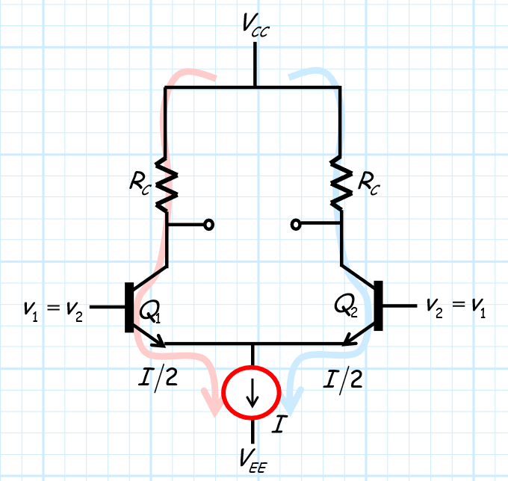
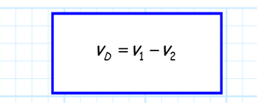
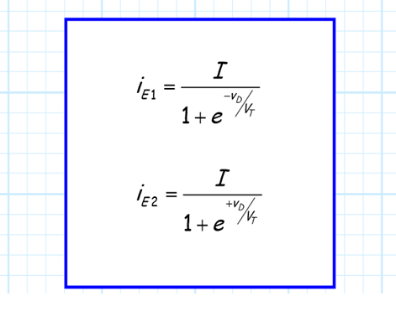

Emetör akımları, VD gerilimine bağlı olarak aşağıdaki gibi yazılabilir:

Slide 10
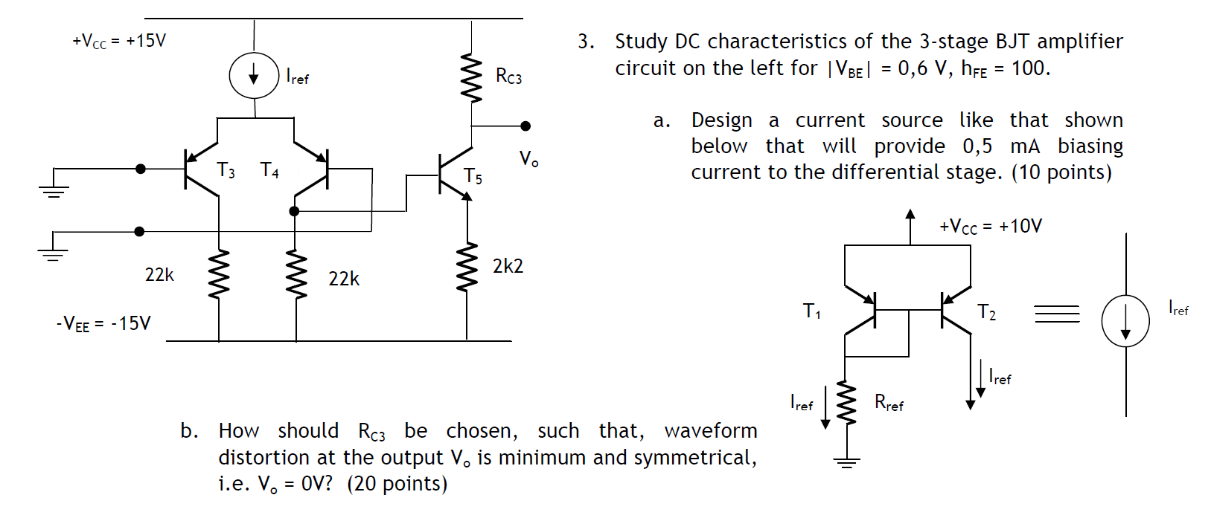
Example

Slide 11
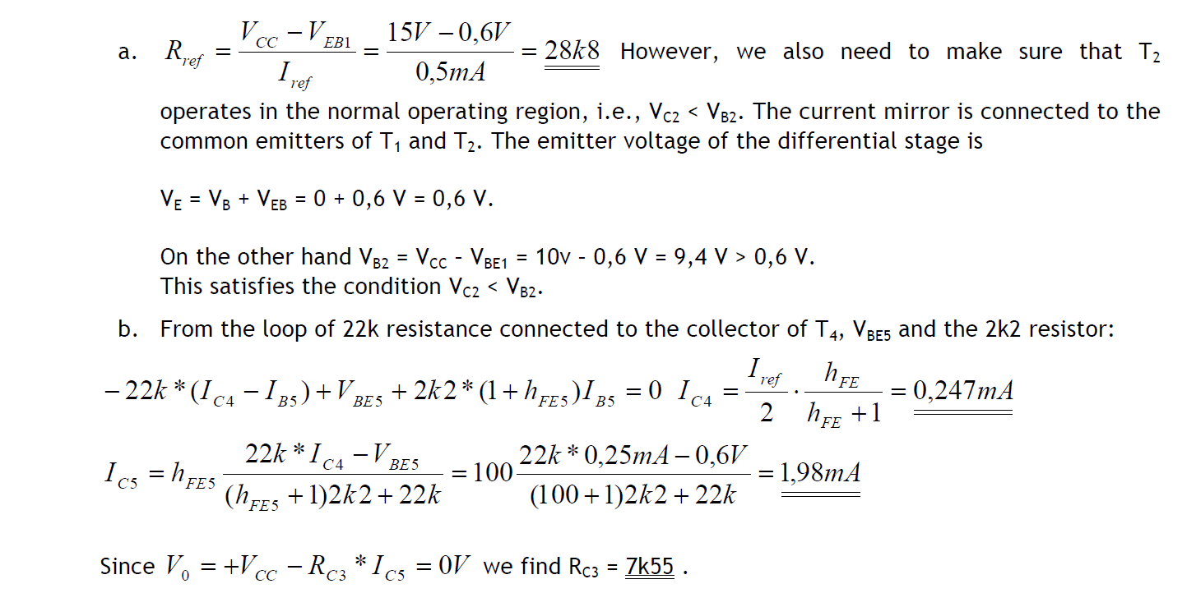

Slide 12
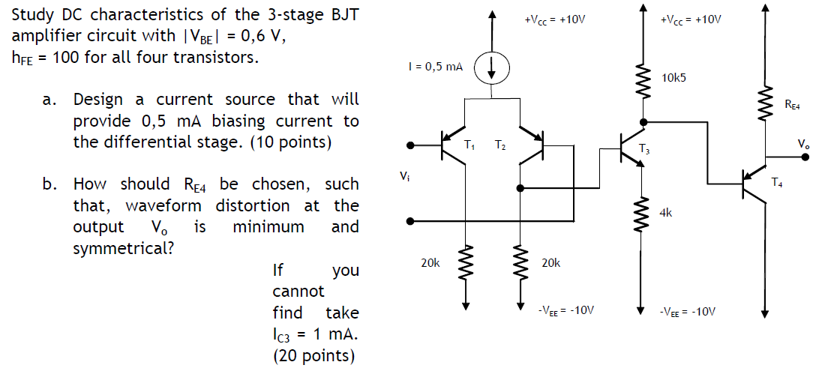
EXAMPLE

Slide 13
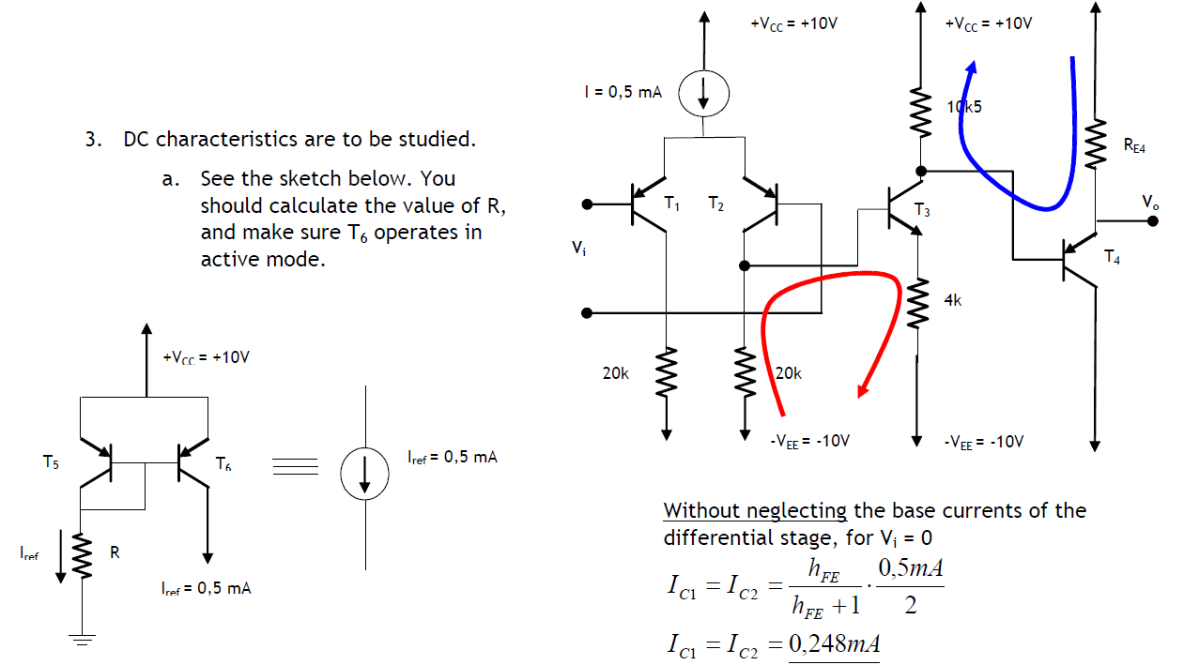

Slide 14
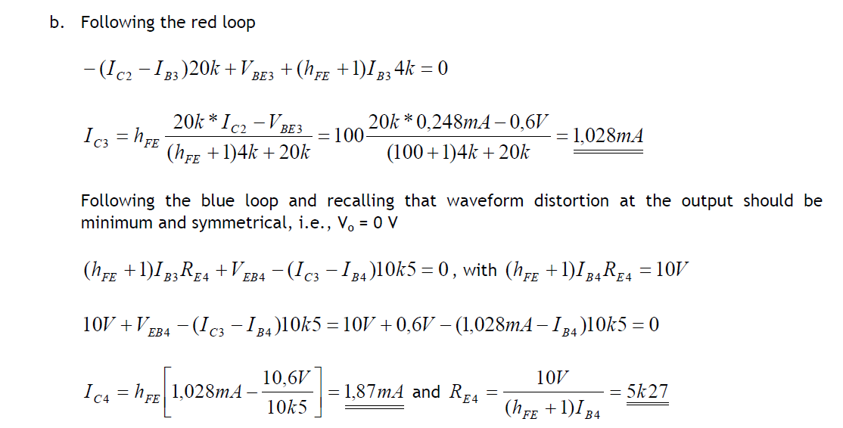

Slide 15
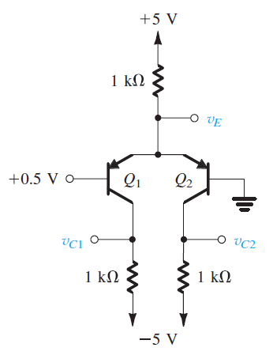
EXAMPLE

